Slide 1
Comparing Toronto and New York
Capstone Project – The Battle of Neighborhoods

Slide 2
Problem & Background
This final project explores the similarity or dissimilarity in aspects from a tourist point of view regarding food, accommodation, beautiful places, and many more.
We will explore, segment, and cluster the neighborhoods in New York City and Toronto, as they are famous places in the world. They are diverse in many ways. Both are multicultural as well as the financial hubs of their respective countries.

Slide 3
Data Description
We have selected two cities to explore their neighborhoods.
For Downtown Toronto we extracted table of Toronto’s Borough from Wikipedia page and cleaned it according to our requirements. Which include eliminating ‘Not assignment’ values, combine neighborhoods that have some geographical coordinates at each borough and sorted against the concerned borough.
For data verification and further exploration, we use Foursquare API to get the coordinates of Downtown Toronto and explore its neighborhoods.
For Manhattan, we used a saved data file which is already explored through foursquare API in which we have extracted all the boroughs of New York and then sorted against the concerned borough.
Then we explored both neighborhoods as venues and venue categories

Slide 4
Methodology
For this problem, we’ll clean the data, and then read it into a pandas dataframe so that it is in a structured format.
Once the data is in a structured format, will get the services of Foursquare API to explore the data of two cities, in terms of their neighborhoods.
The data also include the information about the places around each neighborhood.
We’ll select Manhattan from New York and Downtown Toronto from Toronto.
Will use k-means clustering algorithm to segment the neighborhoods with similar objects on the basis of each neighborhood data. These objects will be given priority on the basis of foot traffic (activity) in their respective neighborhoods.
Finally, we’ll use the Folium library to visualize the neighborhoods in cities and their emerging clusters. This will help to locate the tourist’s areas and hubs..

Slide 5
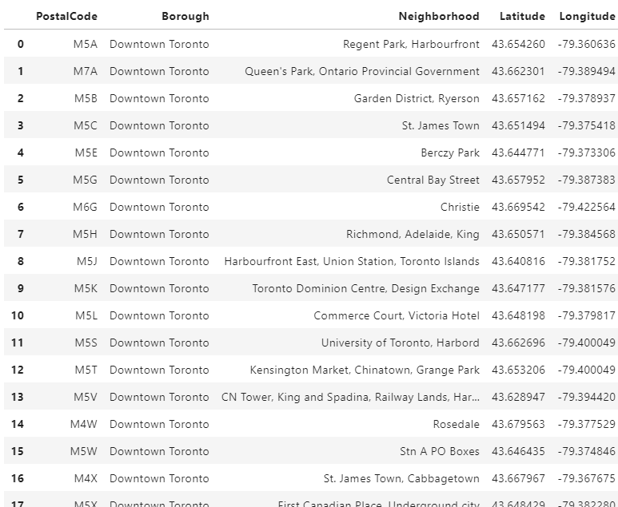
Downtown Toronto
'https://en.wikipedia.org/wiki/List_of_postal_codes_of_Canada:_M‘

Slide 6
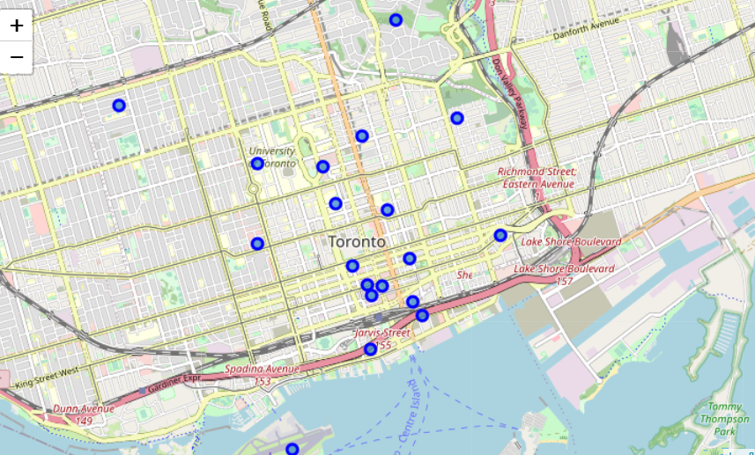

Slide 7
Analysis
We analyze both boroughs neighborhoods through one hot encoding (giving ‘1’ if a venue category is there, and ‘0’ in case of venue category is not there). On the basis of one hot encoding, we calculate mean of the frequency of occurrence of each category and picked top ten venues on that basis for each neighborhood. It means the top venues are showing the foot traffic or the more visited places.

Slide 8
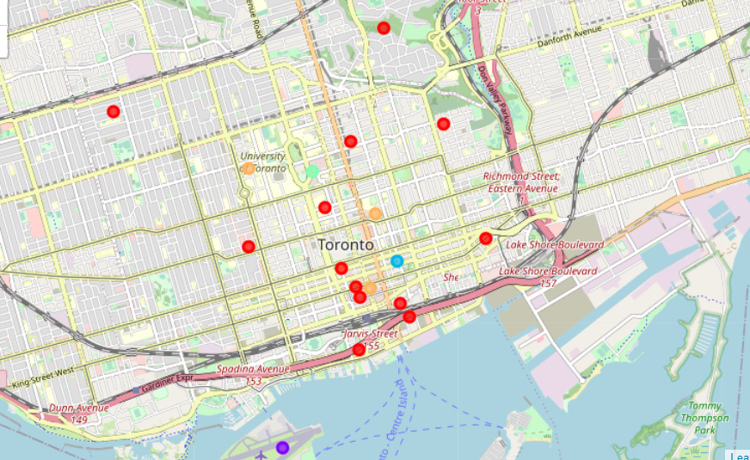
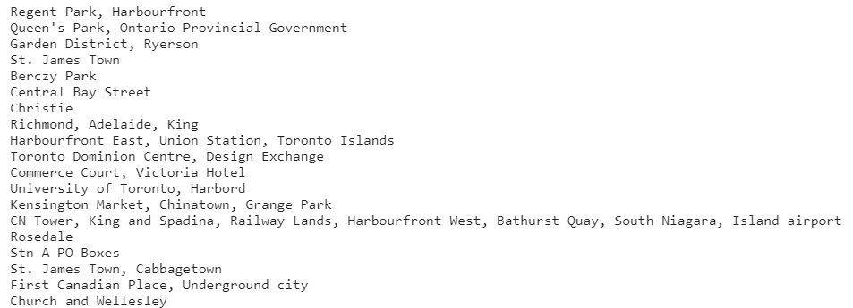
Clustering Downtown Toronto Neighborhoods

Slide 9
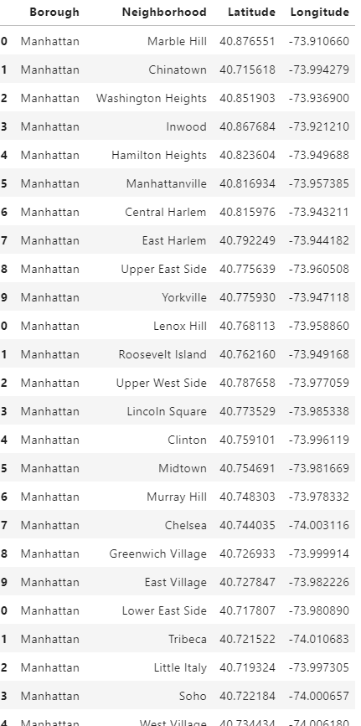
Manhattan New York

Slide 10
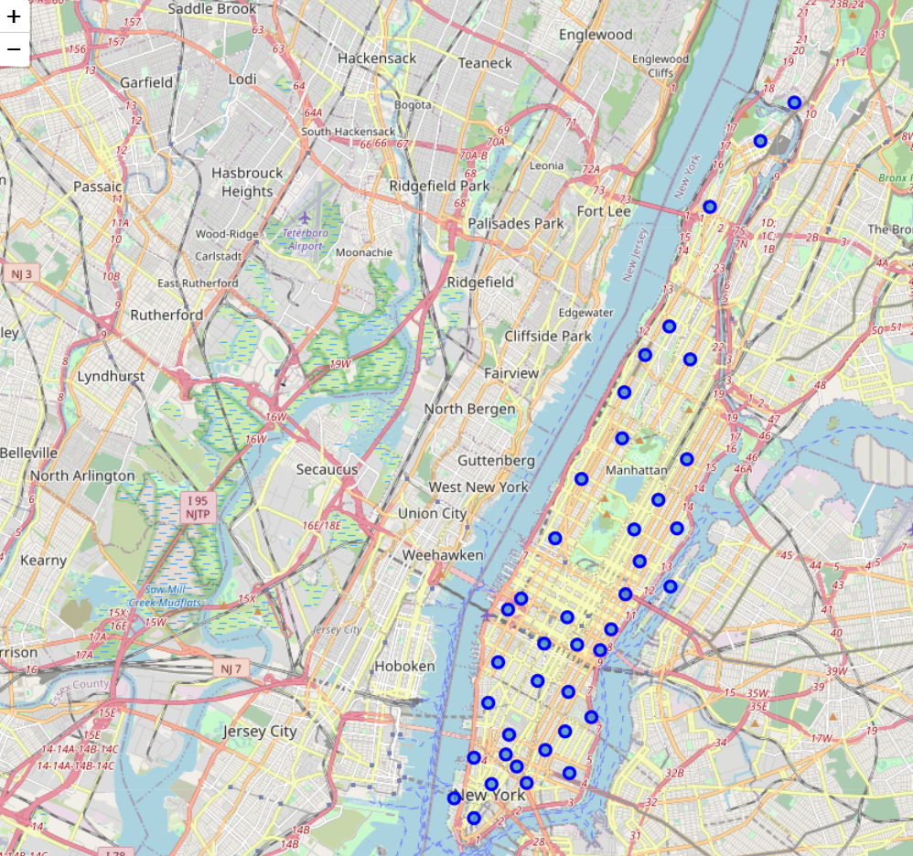

Slide 11
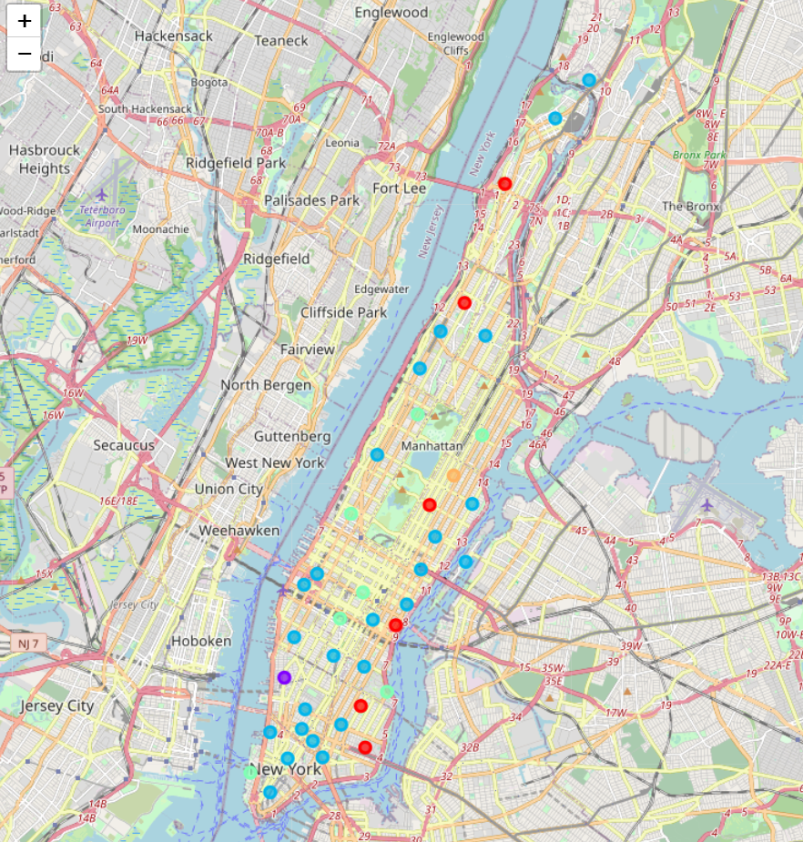
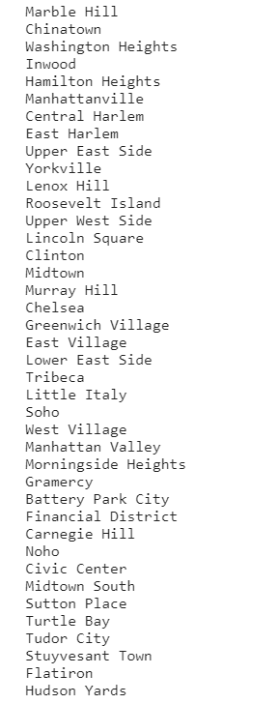
Clustering Manhattan Neighborhoods

Slide 12
Conclusion
After clustering the data of the respective neighborhoods, both cities (Boroughs) have venues which can be explored and attract the Tourists. The neighborhoods are much similar in features like Theaters, opera houses, food places, clubs, museums, parks etc. As far as concern to dissimilarity, it differs in terms of some unique places like historical places and monuments.
The downtown Toronto and Manhattan neighborhoods have more like similar venues. As we know that every place is unique in its own way, so that’s argument is present in both neighborhoods. The dissimilarity exists in terms of some different venues and facilities but not on a larger extent.

